Slide 1
CS4501 Information Retrieval Course Policy
Hongning Wang
CS@UVa

Slide 2
Goal of this course
Discuss fundamental problems in information retrieval
Building blocks of search engine systems
Wide coverage of many IR applications
Personalized recommendation
Online advertising
Get hands-on experience by developing practical systems/components
Prepare students for doing cutting-edge research in information retrieval and related fields
Open the door to the amazing job opportunities in IT industry

Slide 3
Prerequisite
Programming skills – Important!
Basic data structures: CS 2150 or equivalent
Java is required for machine problems
Most open source packages are written in Java
Any language you choose for the rest of this course
Linux system!
Math background
Probability
Discrete/continuous distributions, expectation, moments
Linear algebra
Vector, matrix, dot product
Optimization
Gradient-based methods

Slide 4
Structure of this course
Lecture based
Six major topics will be covered
E.g., Search engine architecture, retrieval models, search evaluation, relevance feedback, link analysis, and IR applications
Introduce state-of-the-art large-scale document processing techniques
E.g., MapReduce framework, Apache Spark and GraphLab

Slide 5

Grading policy
Homework (55%)
Written assignments (~2)
Machine problems (~4)
Midterm exam (25%)
One week before Thanksgiving break
Option A: final exam (25%)
In the exam week
Option B: course project (25%)
Explain later
No curving will be applied!
fairness will be guaranteed by the instructor

Slide 6
Course project
Graduate students
Required, as a replacement of final exam
Topics
Implement algorithms in assigned research papers
Self-selected topics with permission from the instructor
Evaluation
10-minutes in-class presentation (50%)
Written report (50%)

Slide 7
Course project
Undergraduate students
Optional for those who have excellent performance in the midterm exam
Topics
Implement algorithms in assigned research papers
Self-selected topics with permission from the instructor
Evaluation
10-minutes in-class presentation (50%)
Written report (50%)

Slide 8
Late policy
Homework
Submit via Collab (no extension)
Late penalty: 15%, two weeks after the due date; 50%, afterwards
Midterm/Final exams
No make-up exams unless under emergency situation
Course project
Final report due before presentation (no extension)

Slide 9

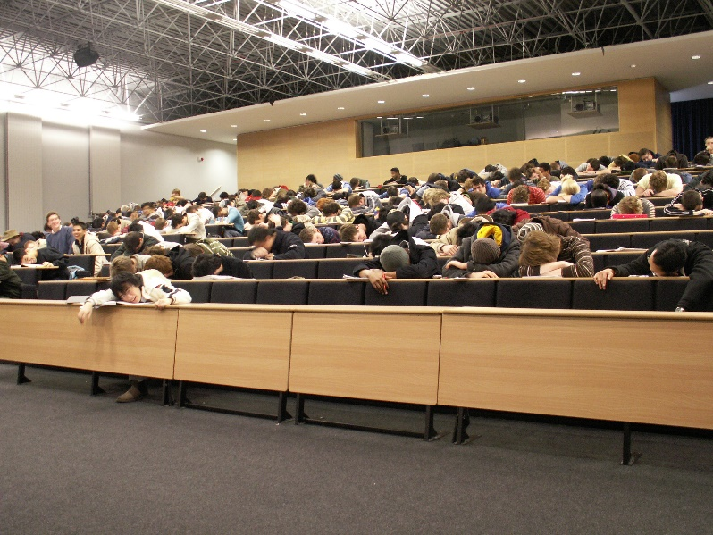
Classroom participation
HIGHLY APPRECIATED!
Helps me quickly remember your names
Reminds me what is still confusing
You can drive the lecture/discussion in this class!

Slide 10
Contact information
Lecture
Instructor: Hongning Wang
Time: Monday/Wednesday 5:00pm to 6:15pm
Location: Olsson Hall 120
Office hour
Instructor’s
Time: Monday/Wednesday 4:00pm to 5:00pm
Location: Rice Hall 408
TAs’
Time: Tuesday/Thursday 2:00pm to 3:00pm
Location: Rice Hall 414
Course website
Website: http://www.cs.virginia.edu/~hw5x/Course/IR2015/_site
Piazza: https://piazza.com/virginia/fall2015/cs4501/home

Slide 11



TAs
Gong Lin
lg5bt@virginia.edu
Qingyun Wu
qw2ky@virginia.edu
Md Mustafizur Rahman mr4xb@virginia.edu

Slide 12
Questions?
Thank you!

